Slide 1
International Culture and Business

Slide 2
Have you ever traveled outside of our country and noticed anything different in our cultures?
-Food
-Dress
-Greetings
-Anything else?

Slide 3
1. What is international business?
International Business includes all commercial transactions that take place between two or more regions, beyond their political boundaries.

Slide 4
2. Why is it important?
Countries do business with each other
We need to be aware of other cultures and how they communicate

Slide 5
3. What does International Business Consist of?
The way we…
Communicate
Greet each other
Negotiate
Have meetings
-Dress
-Respect other cultures
-Eat
-Pay for things
-Travel

Slide 6
4. What is Business Etiquette?
The way in which we should respectively be while in other countries and among different cultures

Slide 7
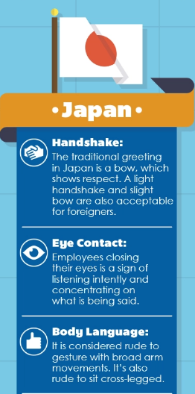
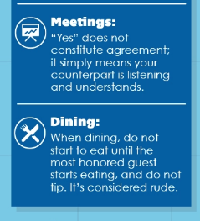
Examples of cultural differences: Japan

Slide 8
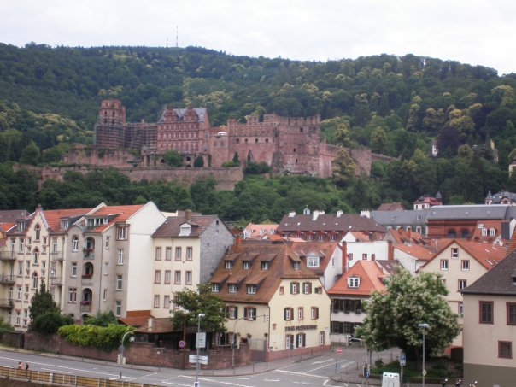
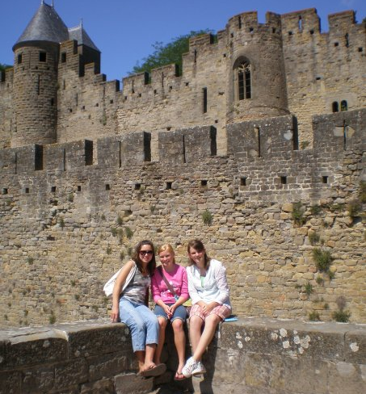
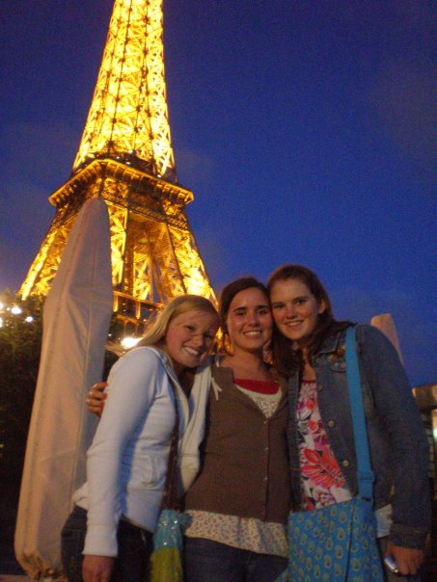
My Europe Trip
Germany
France
Spain

Slide 9
For this project, you will learn about different:
Governments
Dress
Currency
Eating habits
Language
Imports/ exports
Economics

