Slide 1
Business Letter review
How are business letters aligned?
What is the very first line of a business letter?
What are initials at the bottom of the letter for?

Slide 2
Business Communication:
Memos

Slide 3
Writing a Basic Memo Video

Slide 4
Memo
Or a memorandum, is used to communicate within an organization
2. Used for announcements, requests, short reports, and handouts
Can be marked confidential or attached to an email

Slide 5
Format
3. Simple, with five headings: Memo, To, From, Date, Subject
4. Left aligned
Leave a space between heading lines

Slide 6
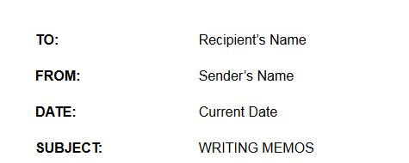
Format
5. Make sure to bold and use uppercase for the heading words

Slide 7
Considerations
Message, purpose, audience, impact, readability and style
Rarely longer than one or two pages
Average length is a few paragraphs
If someone other than the sender types, their initials appear at the bottom, just like the letter

Slide 8
Copy of the memo
*Reference initials go at the bottom if someone else typed the memo (just like the business letter)
7. If someone will receive a copy, their name and a “c” go below the reference initials or last paragraph
ss
c John

Slide 9
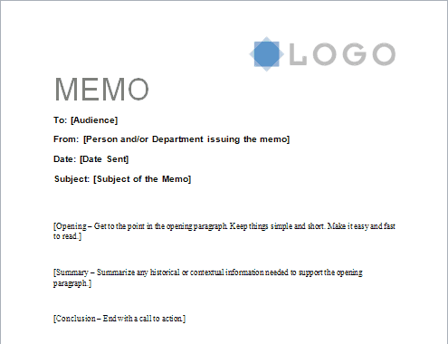
Sample Memo

