Slide 1
Business Communication: Letters

Slide 2
Letter
A formal correspondence
Usually used to communicate with people outside of a company
A letter can be sent to someone within the company if a formal correspondence is necessary
Examples:

Slide 3
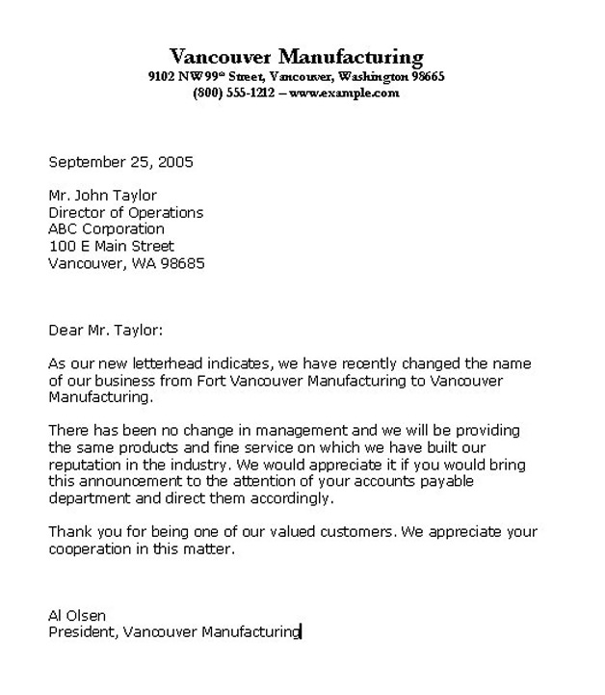
Block style
A business letter style
All lines begin along the left margin
First line: current date

Slide 4
Salutation
A formal greeting
Use a title: Mr., Mrs., or Ms.

Slide 5
Closing
A formal “goodbye” or “thank you”
Use a typed name and a signed name

Slide 6
Initials and Enclosures
Initials of the person who typed the letter go below the sender’s typed name (if it’s someone other than the sender)
Enclosures: Other items that will be included in the same envelope

Slide 7
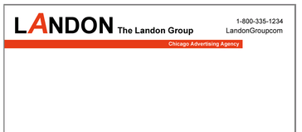
Additional Tips
Letters should be printed on letterhead
-Letterhead: pre-printed corporate stationary on high-quality paper

Slide 8
Additional Tips
Spell-check and proofread!!
Letters with errors create an unfavorable impression
Consider the audience, purpose, tone, and length of the message

Slide 9
Additional Tips
Gain the reader’s interest in the first paragraph
State your requests clearly, so the reader knows what you want and when you need the request completed
Don’t print a 2-sided letter, continue on a new page

Slide 10
Sample Letter

